Slide 1
Getting Ready for Virtual Learning
What to expect

Slide 2
Starting School Virtually: do you have what you need?
Laptop or Computer
WIFI or Internet
School Supplies

Slide 3
Time to wake up!
In order to have a successful morning, it is so important to start your day with a healthy breakfast. Breakfast is a very important meal that will help you concentrate throughout the day.

Slide 4
A Quiet Place!
Find a quiet place and get ready to start your day.
Focus, focus,
focus...

Slide 5
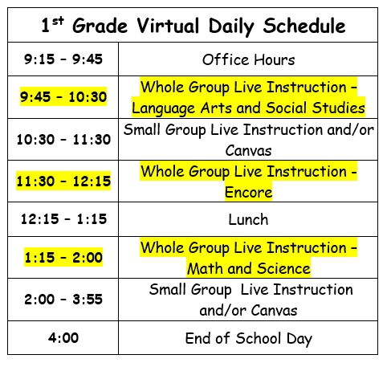
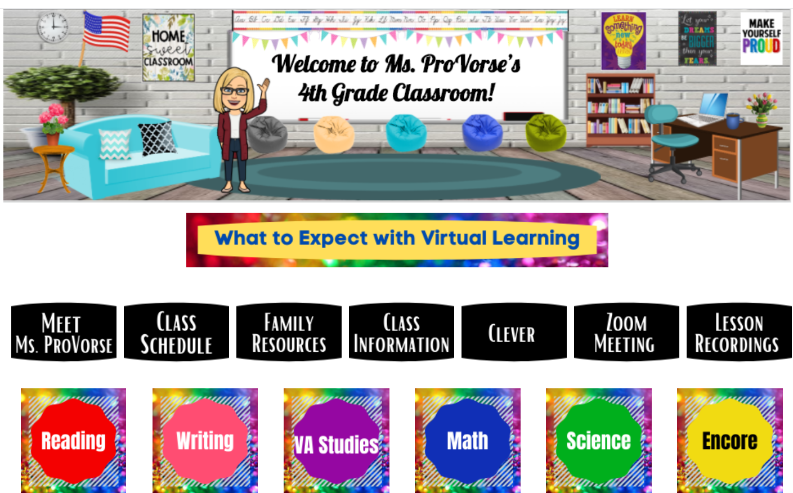
Let’s check to see what we will need to begin learning on the first day of school.
SCHEDULE
SUPPLIES
Technology Check
Is your computer charged?
Do you have your Zoom meeting links?
Is your volume on?
Is your WIFI working?
Check your microphone, speakers and
camera.
Do you know where to access the daily schedule?
Are your supplies near you?

Slide 6
Your Daily Schedule
This is your daily schedule. At 9:35 each morning, you will need to log in to Canvas and click on the Zoom button to join our live meeting, which will begin promptly at 9:45.
Whenever you see the yellow highlighted sections, that means EVERYBODY will be in a live meeting using Zoom.
Sometimes while we are live, you will be working in small groups with a teacher while others are working independently in Canvas.
You will be assigned to a small group for Language Arts/Social Studies and Math/Science. We highly suggest students have a timer to help them know when to rejoin Zoom for small group lessons.
When you are not in a live meeting, you will be working independently, either in Canvas or offline.

Slide 7
Canvas Guide for Parents and Students
First Grade 2020-2021

Slide 8
What is Canvas?
Canvas is our online learning platform. Here you can:
Access your online classes (Math, Writing, Reading, Science, Social Studies, and Encore)
Join your daily live class meetings in Zoom
Join small group meetings to practice reading and math skills
Complete your daily class activities
Turn in your daily assignments
Receive important announcements

Slide 9
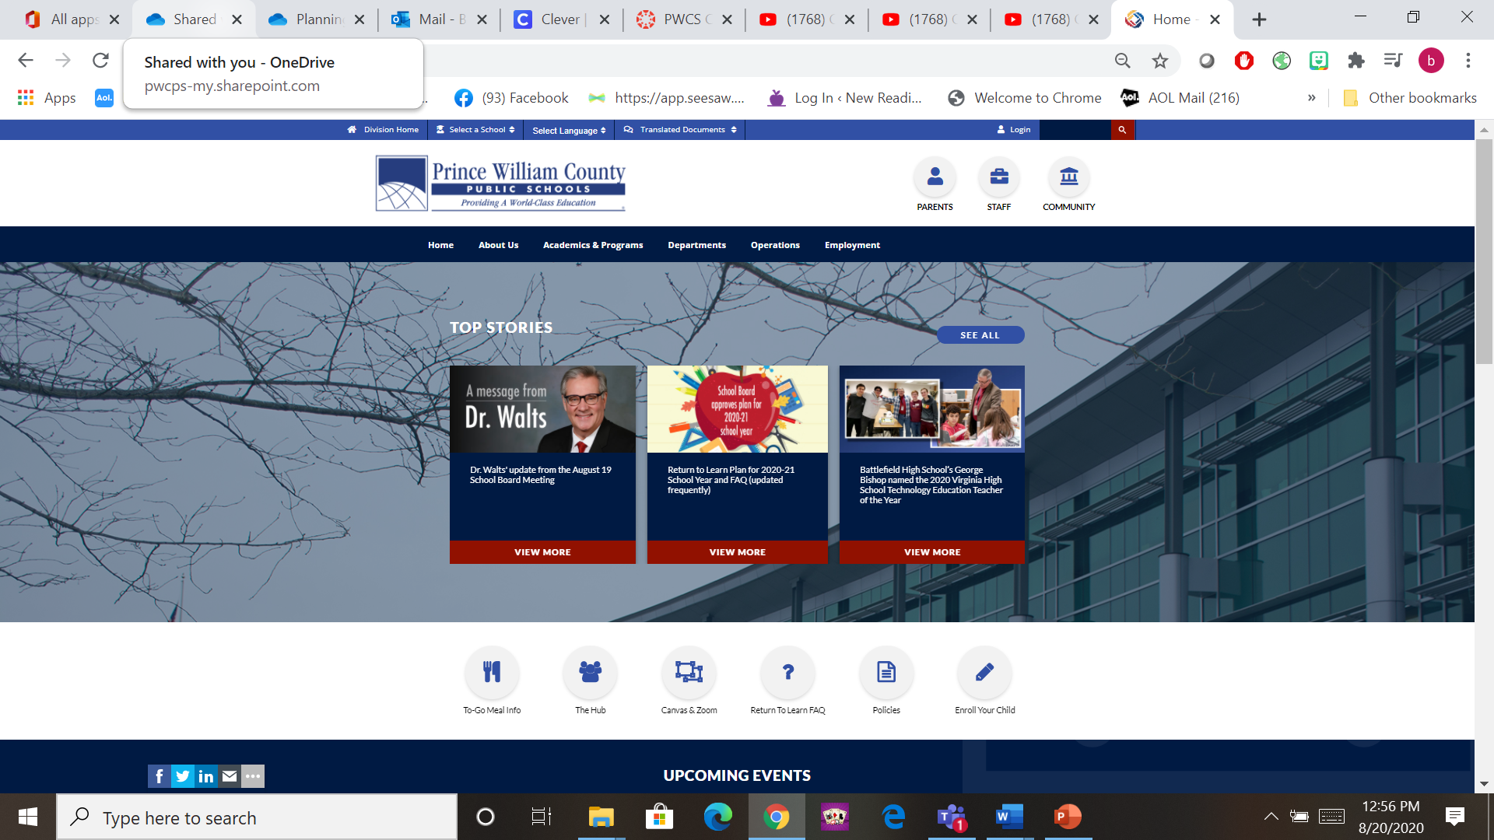
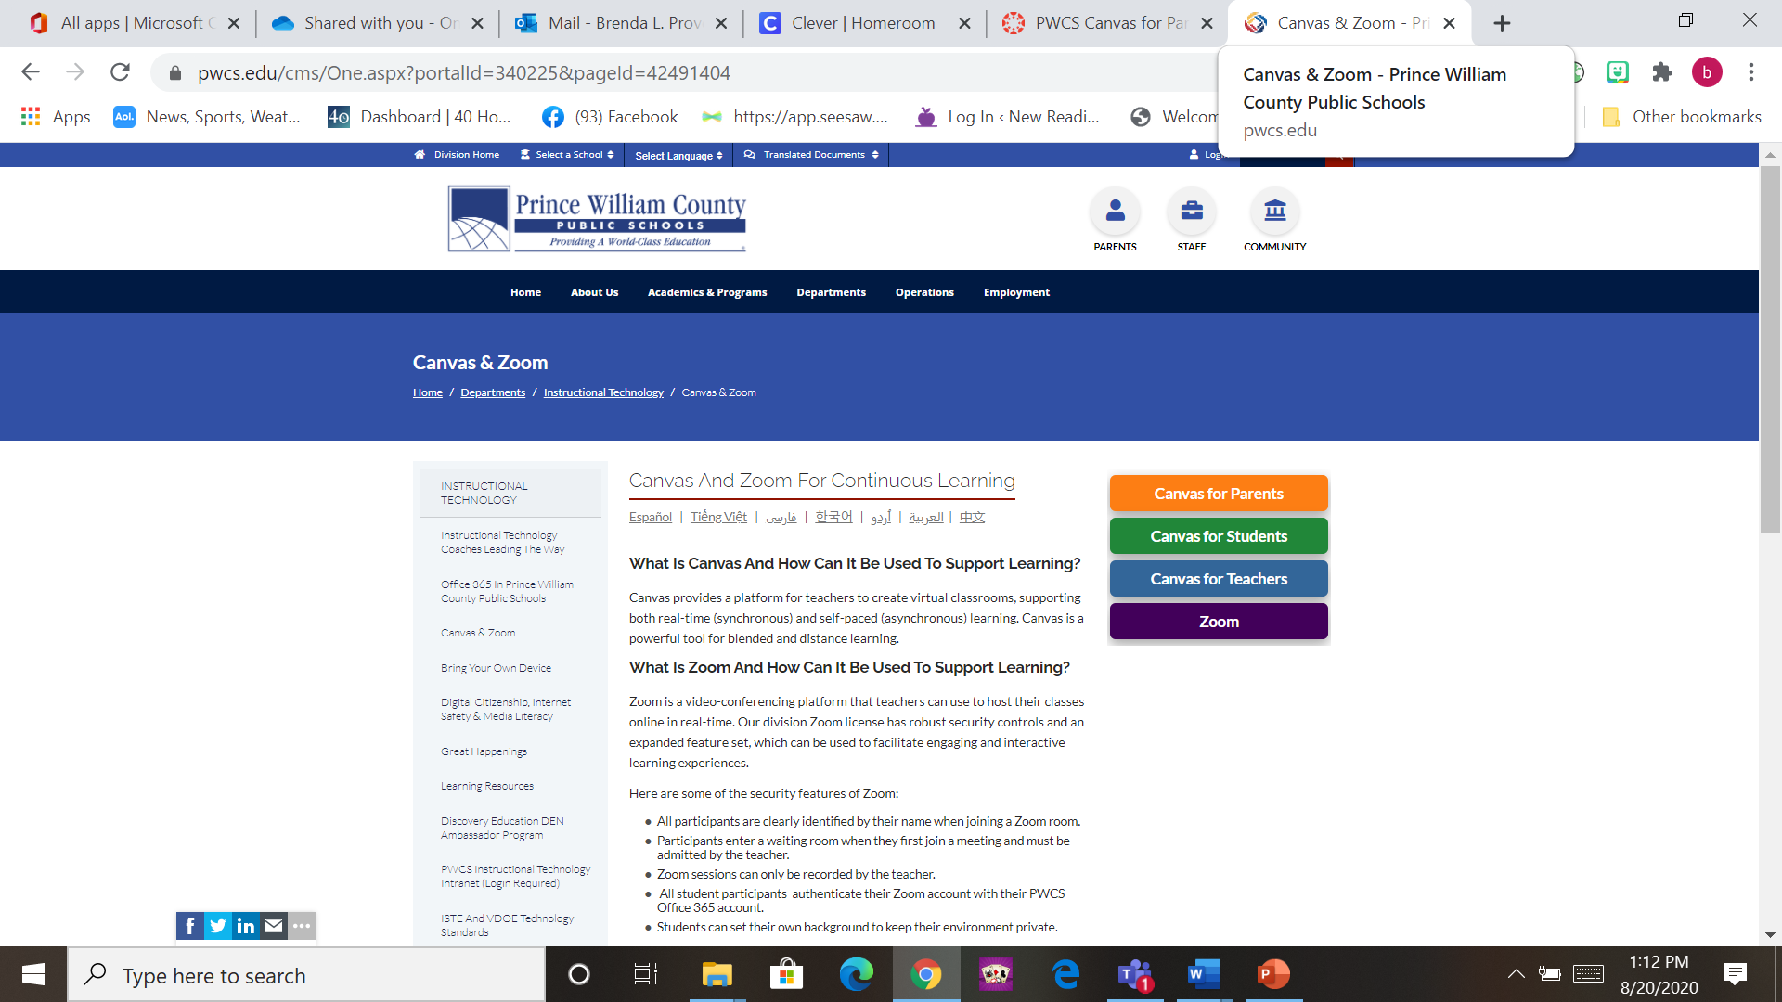
Accessing Canvas
Go to the PWCS website:
pwcs.edu
2. Click on “Canvas and Zoom.”
3. Click on “Canvas for Parents.”

Slide 10
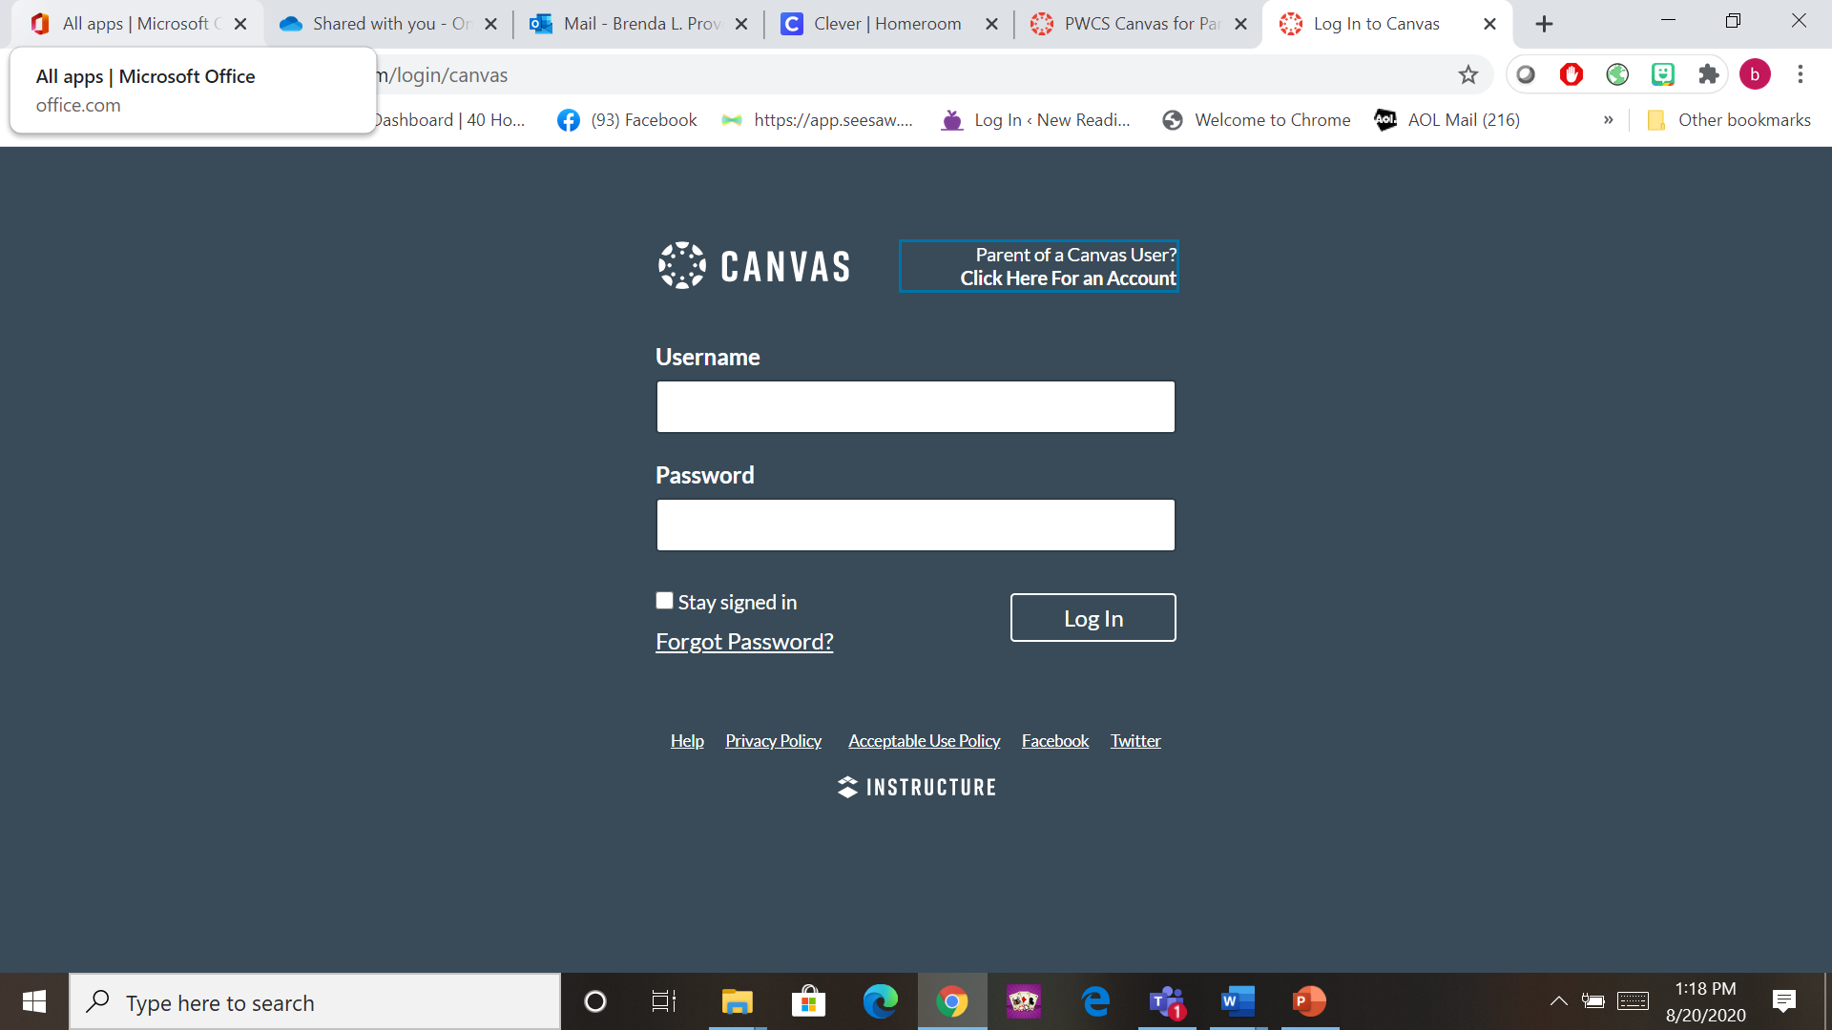
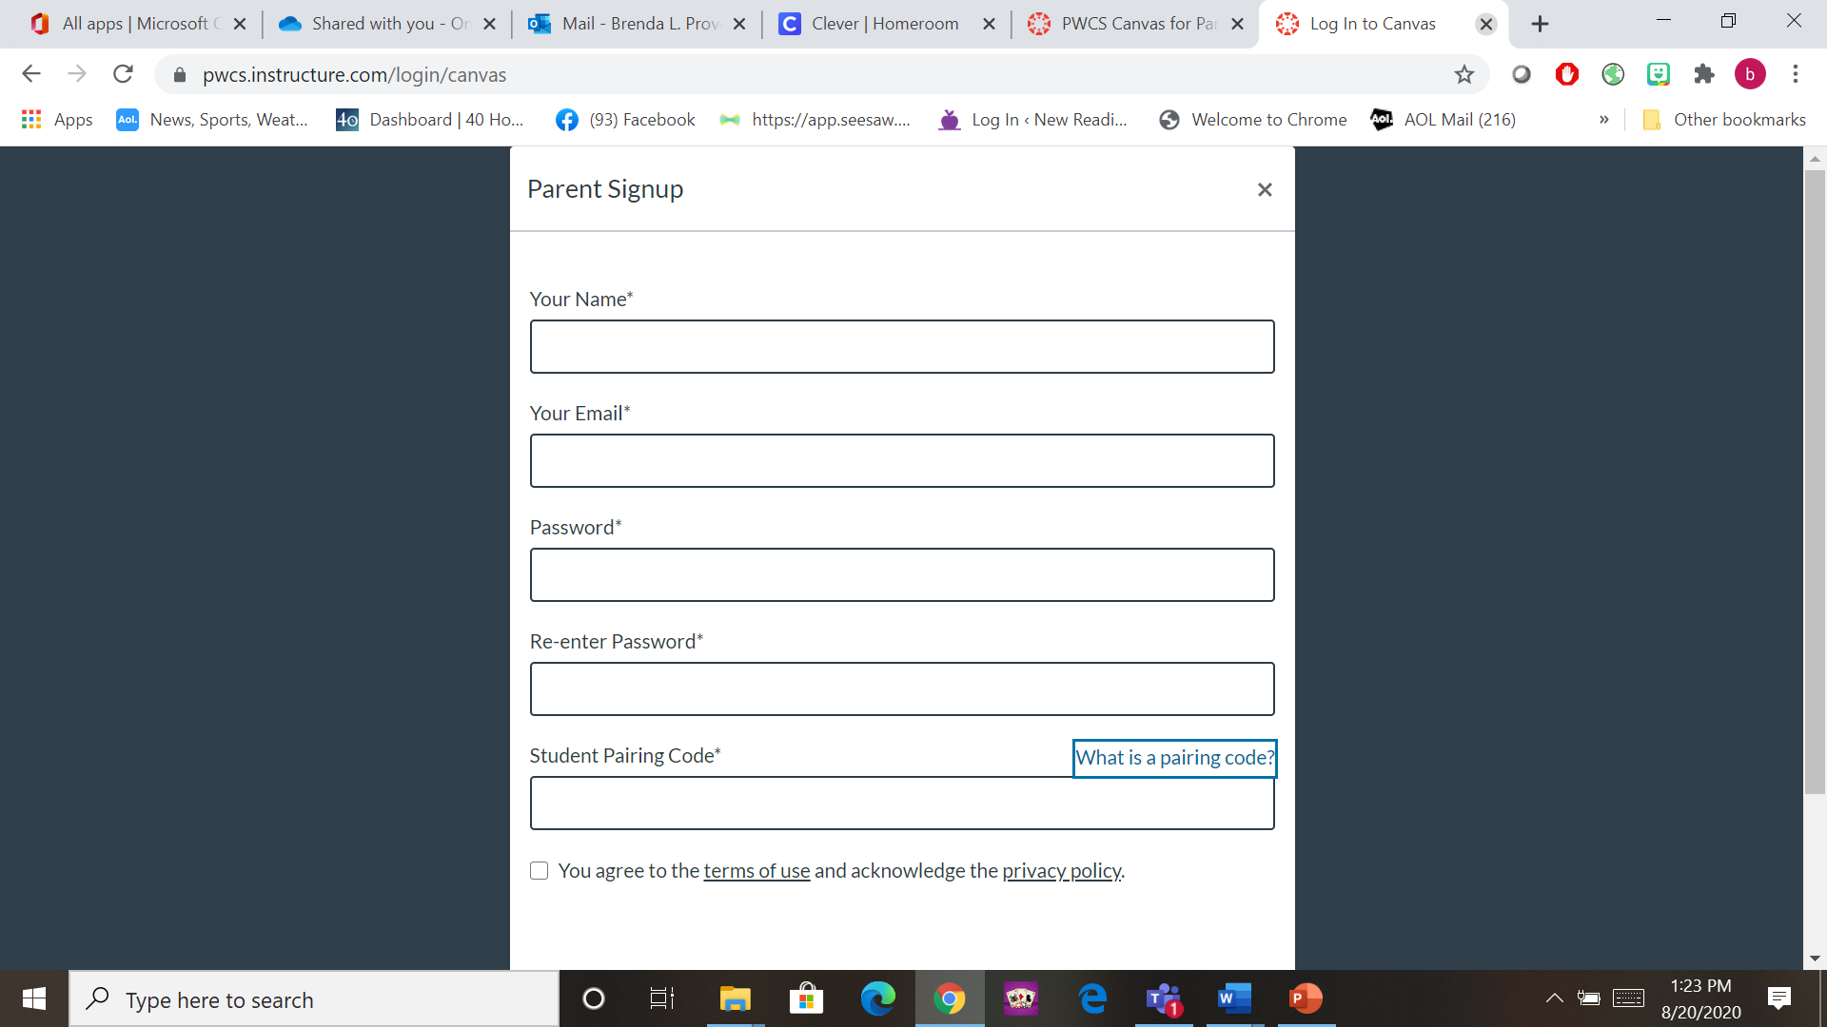
Accessing Canvas (cont.)
4. Click on “Parent of a Canvas User.”
5. Enter your information to create an account.
6. Watch the video to find your student pairing code and finish setting up your account.

Slide 11
Navigating Canvas

Slide 12
Canvas Course Navigation

Slide 13
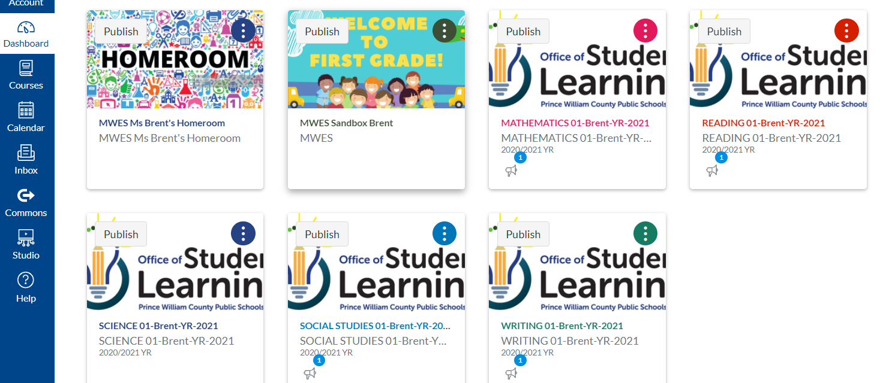
Accessing Canvas as a Student
Ipad – Select the Canvas icon
2. Select Homeroom

Slide 14
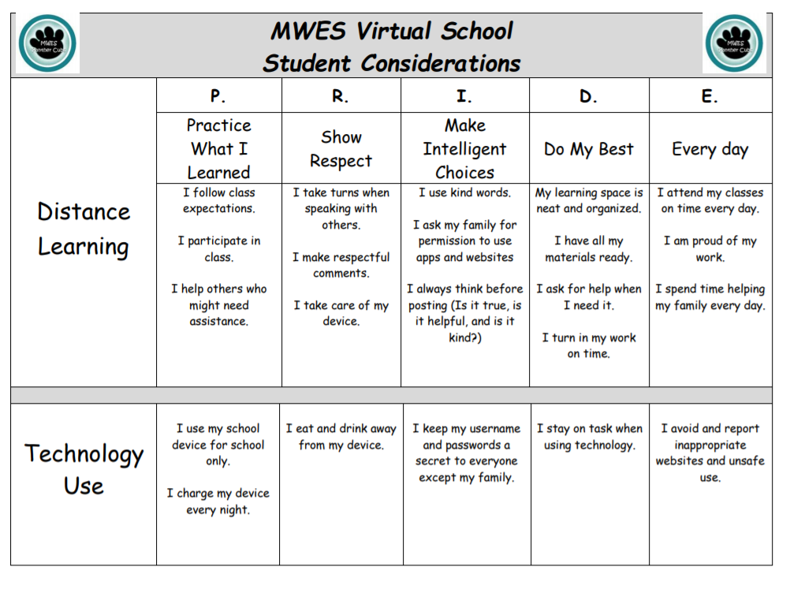

Slide 15
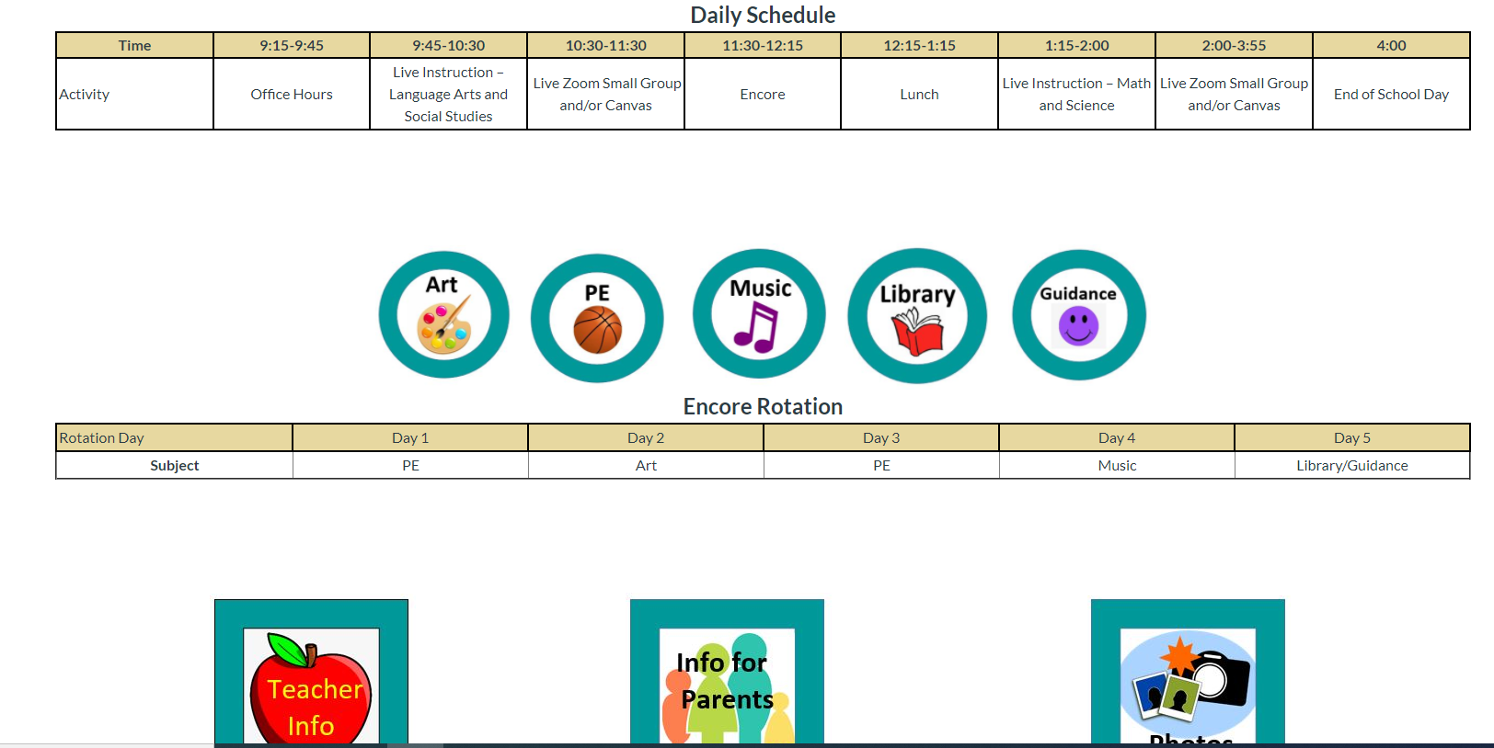
Navigating Your Child's Canvas Homepage
Parent Preferred Contact:
In order to have access to your classes, you must accept the invitations that will be emailed to your preferred email address/s.

